Slide 1
ECEN 150 Circuit Analysis I
Nodal and Mesh Analysis

Slide 2
Barnyard Example
A farmer counts heads and feet of pigs and chickens in his barnyard, and get 17 heads and 40 feet. How many chickens and pigs does the farmer have?
Two Equations → Two Unknowns
pigs + chickens = 17. (Number of heads).
4pigs + 2chickens = 40. (Number of feet).
Can Solve by Substitution
chickens = 17 – pigs. (Substitute this expression into 4pigs + 2chickens = 40.)
4pigs + 2(17 – pigs) = 40. 4pigs - 2pigs + 34 = 40. 2pigs = 6. pigs = 3.
chickens = 17 – 3 = 14. chickens = 14.
Solution → (3 pigs, 14 chickens.)

Slide 3
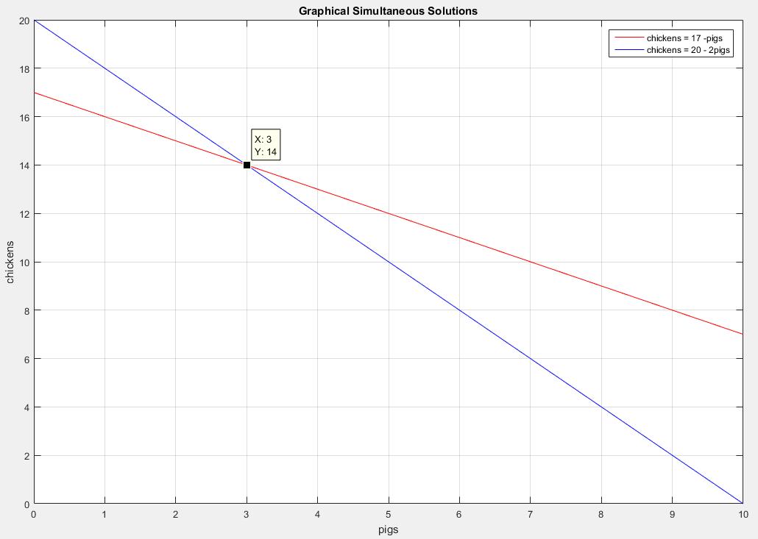
Barnyard Example (Continued)
A farmer counts heads and feet of pigs and chickens in his barnyard, and get 17 heads and 40 feet. How many chickens and pigs does the farmer have?
chickens = 17 – pigs.
Graphical Approach: chickens = 20 - 2pigs.
Solution → (3 pigs, 14 chickens.)

Slide 4
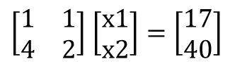
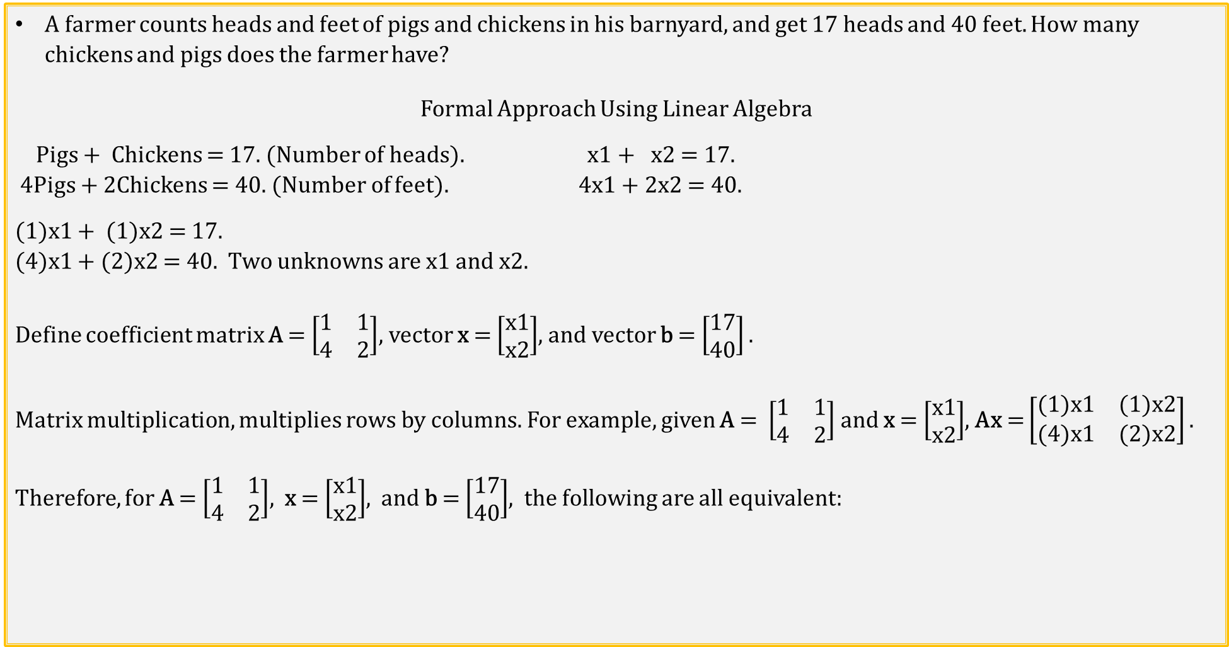
Barnyard Example (Continued)
A farmer counts heads and feet of pigs and chickens in his barnyard, and get 17 heads and 40 feet. How many chickens and pigs does the farmer have?
Formal Approach Using Linear Algebra
Pigs + Chickens = 17. (Number of heads). x1 + x2 = 17.
4Pigs + 2Chickens = 40. (Number of feet). 4x1 + 2x2 = 40.
(1)x1 + (1)x2 = 17.
(4)x1 + (2)x2 = 40. Two unknowns are x1 and x2.
Define coefficient matrix A = $\left[\begin{matrix}1 & 1 \\ 4 & 2\end{matrix}\right]$, vector x = $\left[\begin{aligned}x1 \\ x2\end{aligned}\right]$, and vector b = $\left[\begin{aligned}17 \\ 40\end{aligned}\right].$
Matrix multiplication, multiplies rows by columns. For example, given A = $\left[\begin{matrix}1 & 1 \\ 4 & 2\end{matrix}\right]$ and x = $\left[\begin{aligned}x1 \\ x2\end{aligned}\right]$, Ax = $\left[\begin{matrix}(1)x1 & (1)x2 \\ (4)x1 & (2)x2\end{matrix}\right].$
Therefore, for A = $\left[\begin{matrix}1 & 1 \\ 4 & 2\end{matrix}\right]$, x = $\left[\begin{aligned}x1 \\ x2\end{aligned}\right]$, and b = $\left[\begin{aligned}17 \\ 40\end{aligned}\right]$, the following are all equivalent:
A
x
b
x1 + x2 = 17.
4x1 + 2x2 = 40.
$\left[\begin{matrix}1 & 1 \\ 4 & 2\end{matrix}\right]$ $\left[\begin{aligned}x1 \\ x2\end{aligned}\right]=\left[\begin{aligned}17 \\ 40\end{aligned}\right]$
Ax = b

Slide 5
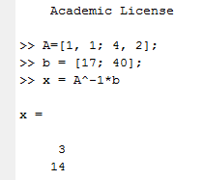
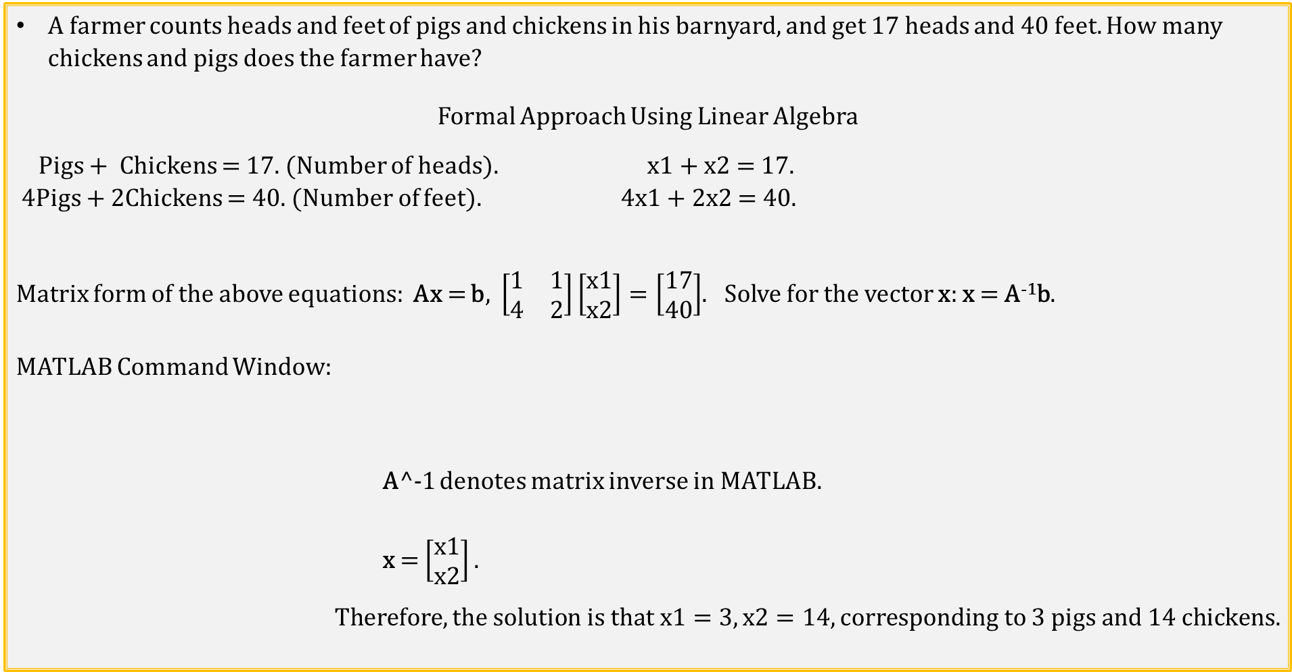
Barnyard Example (Continued) (Continued)
A farmer counts heads and feet of pigs and chickens in his barnyard, and get 17 heads and 40 feet. How many chickens and pigs does the farmer have?
Formal Approach Using Linear Algebra
Pigs + Chickens = 17. (Number of heads). x1 + x2 = 17.
4Pigs + 2Chickens = 40. (Number of feet). 4x1 + 2x2 = 40.
Matrix form of the above equations: Ax = b, $\left[\begin{matrix}1 & 1 \\ 4 & 2\end{matrix}\right]\left[\begin{aligned}x1 \\ x2\end{aligned}\right]=\left[\begin{aligned}17 \\ 40\end{aligned}\right]$. Solve for the vector x: x = A⁻¹b.
MATLAB Command Window:
A^-1 denotes matrix inverse in MATLAB.
x = $\left[\begin{aligned}x1 \\ x2\end{aligned}\right].$
$$Therefore, the solution is that x1=3, x2=14, corresponding to 3 pigs and 14 chickens.$$
A
x
b

Slide 6
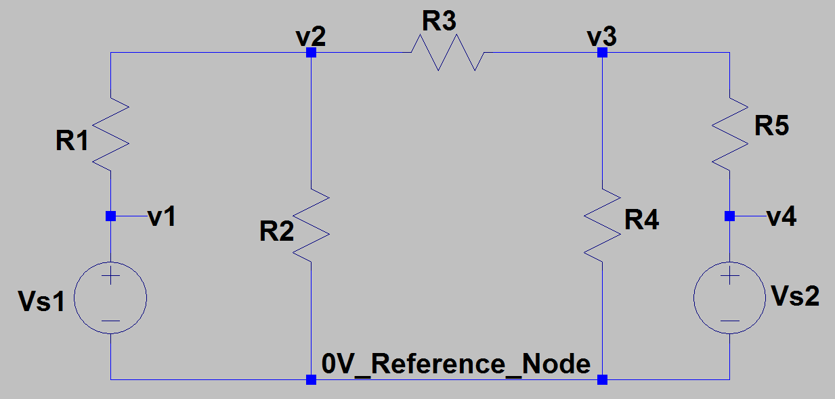
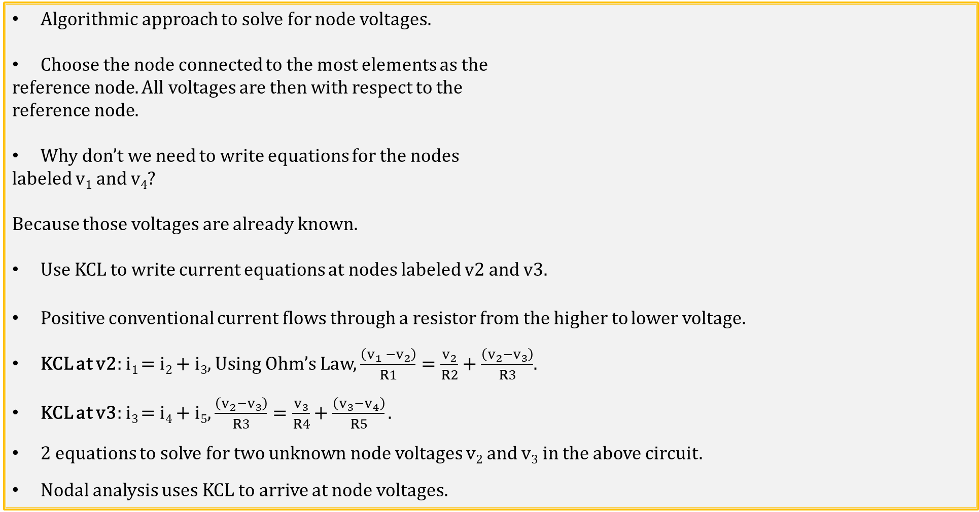
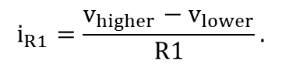
Nodal Analysis
Algorithmic approach to solve for node voltages.
Choose the node connected to the most elements as the
reference node. All voltages are then with respect to the
reference node.
Why don’t we need to write equations for the nodes
labeled v₁ and v₄?
Because those voltages are already known.
Use KCL to write current equations at nodes labeled v2 and v3.
Positive conventional current flows through a resistor from the higher to lower voltage.
KCL at v2: i₁ = i₂ + i₃, Using Ohm’s Law, $\frac{\left(v_{1} −v_{2}\right)}{R1}=\frac{v_{2}}{R2}+\frac{\left(v_{2}−v_{3}\right)}{R3}$.
KCL at v3: i₃ = i₄ + i₅, $\frac{\left(v_{2}−v_{3}\right)}{R3}=\frac{v_{3}}{R4}+\frac{\left(v_{3}−v_{4}\right)}{R5}.$
2 equations to solve for two unknown node voltages v₂ and v₃ in the above circuit.
Nodal analysis uses KCL to arrive at node voltages.
i₁
i₃
i₃
i₅
i₂
i₄
i_{R1}
+
_
v_{higher}
v_{lower}
$$i_{R1}=\frac{v_{higher}−v_{lower}}{R1}.$$
R1

Slide 7
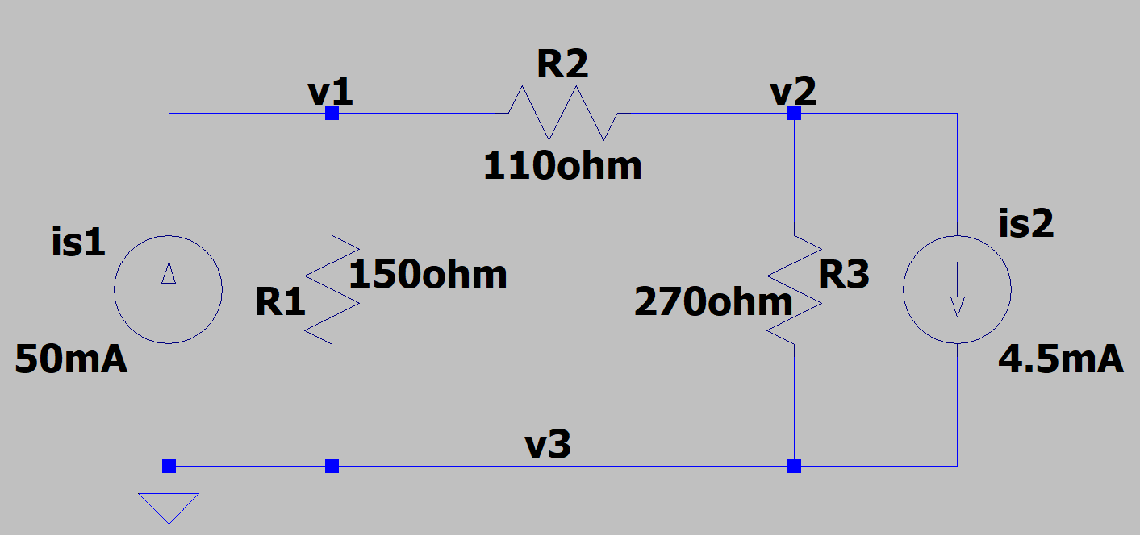
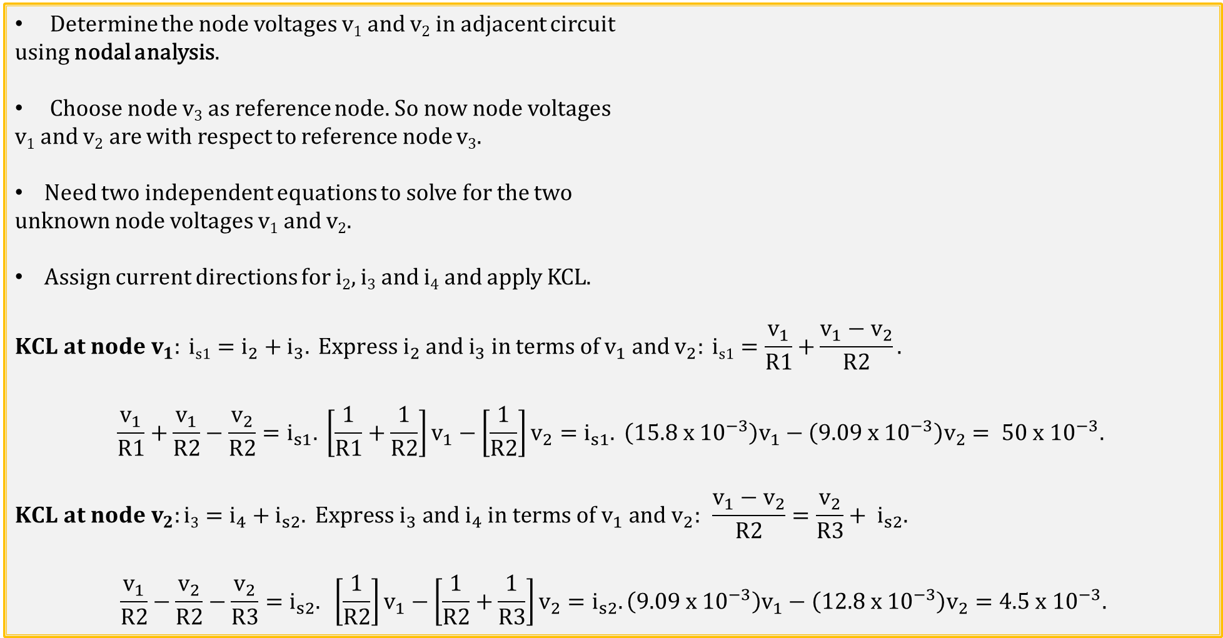
Nodal Analysis Example 1
Determine the node voltages v₁ and v₂ in adjacent circuit
using nodal analysis.
Choose node v₃ as reference node. So now node voltages
v₁ and v₂ are with respect to reference node v₃.
Need two independent equations to solve for the two
unknown node voltages v₁ and v₂.
Assign current directions for i₂, i₃ and i₄ and apply KCL.
$$KCL at node v_{1}: \text{i}\text{s}\text{1}=i_{2}+i_{3}. Express i_{2} and i_{3} \text{in} \text{terms} \text{of} v_{1} and v_{2}: \text{i}\text{s}\text{1}=\frac{v_{1}}{R1}+\frac{{v_{1}−v}_{2}}{R2}.$$
$$\frac{v_{1}}{R1}+\frac{v_{1}}{R2}−\frac{v_{2}}{R2}=i_{s1}. \left[\frac{1}{R1}+\frac{1}{R2}\right]v_{1}−\left[\frac{1}{R2}\right]v_{2}=i_{s1}. \left(15.8 x {10}^{−3}\right)v_{1}−\left(9.09 x {10}^{−3}\right)v_{2}= 50 x {10}^{−3}.$$
$$KCL at node v_{2}:\text{i}\text{3}=i_{4}+i_{s2}. Express i_{3} and i_{4} \text{in} \text{terms} \text{of} v_{1} and v_{2}: \frac{{v_{1}−v}_{2}}{R2}=\frac{v_{2}}{R3}+ i_{s2}.$$
$$\frac{v_{1}}{R2}−\frac{v_{2}}{R2}−\frac{v_{2}}{R3}=i_{s2}. \left[\frac{1}{R2}\right]v_{1}−\left[\frac{1}{R2}+\frac{1}{R3}\right]v_{2}=i_{s2}. \left(9.09 x {10}^{−3}\right)v_{1}−\left(12.8 x {10}^{−3}\right)v_{2}=4.5 x {10}^{−3}.$$
i₃
i₃
i₂
i₄

Slide 8
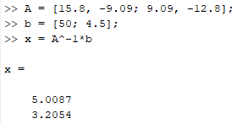
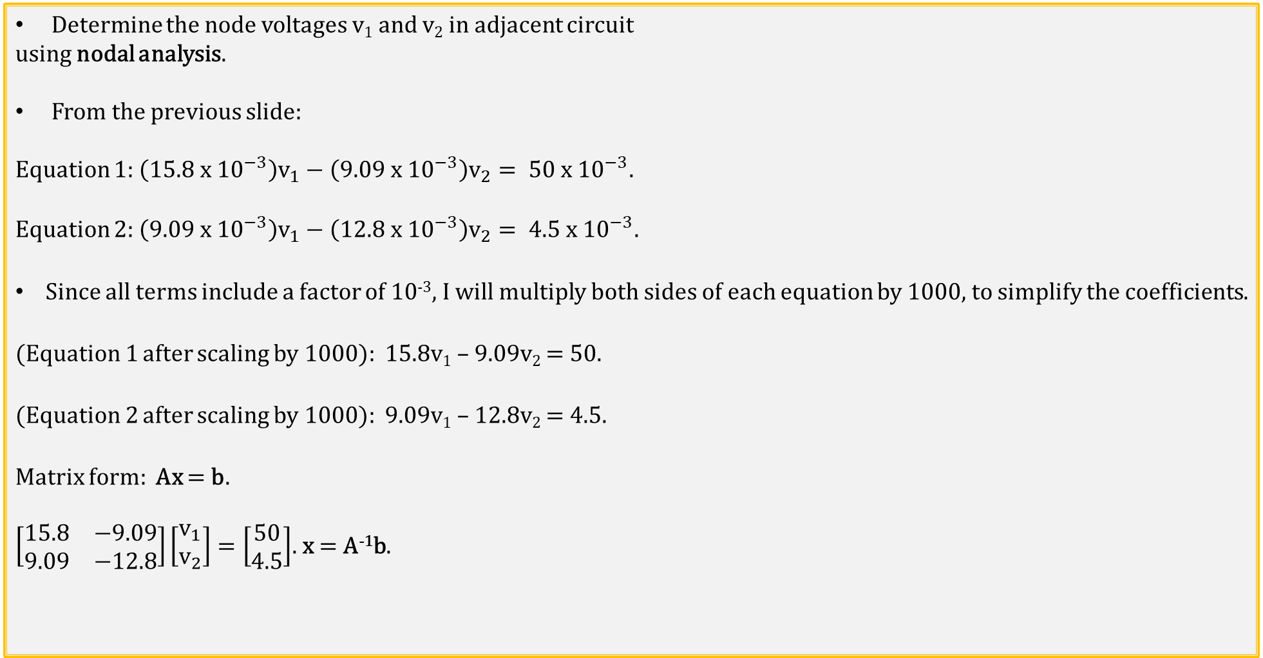
Nodal Analysis Example 1 (Continued)
Determine the node voltages v₁ and v₂ in adjacent circuit
using nodal analysis.
From the previous slide:
Equation 1: $\left(15.8 x {10}^{−3}\right)v_{1}−\left(9.09 x {10}^{−3}\right)v_{2}= 50 x {10}^{−3}.$
Equation 2: $\left(9.09 x {10}^{−3}\right)v_{1}−\left(12.8 x {10}^{−3}\right)v_{2}= 4.5 x {10}^{−3}.$
Since all terms include a factor of 10⁻³, I will multiply both sides of each equation by 1000, to simplify the coefficients.
(Equation 1 after scaling by 1000): 15.8v₁ – 9.09v₂ = 50.
(Equation 2 after scaling by 1000): 9.09v₁ – 12.8v₂ = 4.5.
Matrix form: Ax = b.
$\left[\begin{matrix}15.8 & −9.09 \\ 9.09 & −12.8\end{matrix}\right]\left[\begin{aligned}v_{1} \\ v_{2}\end{aligned}\right]=\left[\begin{aligned}50 \\ 4.5\end{aligned}\right]$. x = A⁻¹b.
i₃
i₃
i₂
i₄
MATLAB Command Window
Poll Questions
v₁ = 5.01 V. v₂ = 3.20 V.

Slide 9
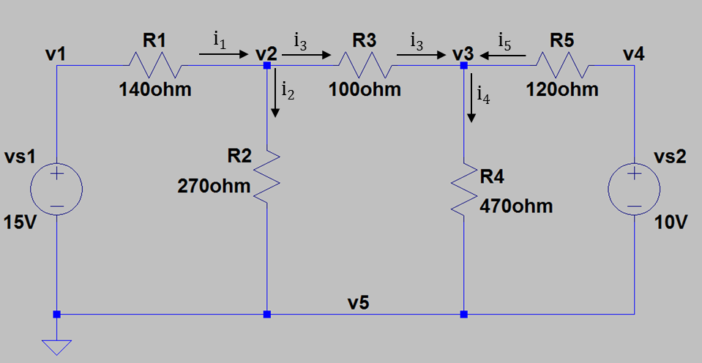
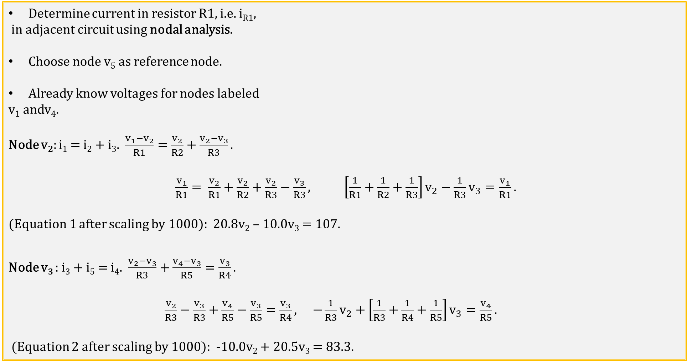
Nodal Analysis Example 2
Determine current in resistor R1, i.e. i_{R1},
in adjacent circuit using nodal analysis.
Choose node v₅ as reference node.
Already know voltages for nodes labeled
v₁ andv₄.
Node v₂: i₁ = i₂ + i₃. $\frac{v_{1}−v_{2}}{R1}=\frac{v_{2}}{R2}+\frac{v_{2}−v_{3}}{R3}.$
$\frac{v_{1}}{R1}= \frac{v_{2}}{R1}+\frac{v_{2}}{R2}+\frac{v_{2}}{R3}−\frac{v_{3}}{R3}, \left[\frac{1}{R1}+\frac{1}{R2}+\frac{1}{R3}\right]v_{2}−\frac{1}{R3}v_{3}=\frac{v_{1}}{R1}.$
(Equation 1 after scaling by 1000): 20.8v₂ – 10.0v₃ = 107.
Node v₃ : i₃ + i₅ = i₄. $\frac{v_{2}−v_{3}}{R3}+\frac{v_{4}−v_{3}}{R5}=\frac{v_{3}}{R4}.$
$\frac{v_{2}}{R3}−\frac{v_{3}}{R3}+\frac{v_{4}}{R5}−\frac{v_{3}}{R5}=\frac{v_{3}}{R4}, −\frac{1}{R3}v_{2}+\left[\frac{1}{R3}+\frac{1}{R4}+\frac{1}{R5}\right]v_{3}=\frac{v_{4}}{R5}.$
(Equation 2 after scaling by 1000): -10.0v₂ + 20.5v₃ = 83.3.

Slide 10
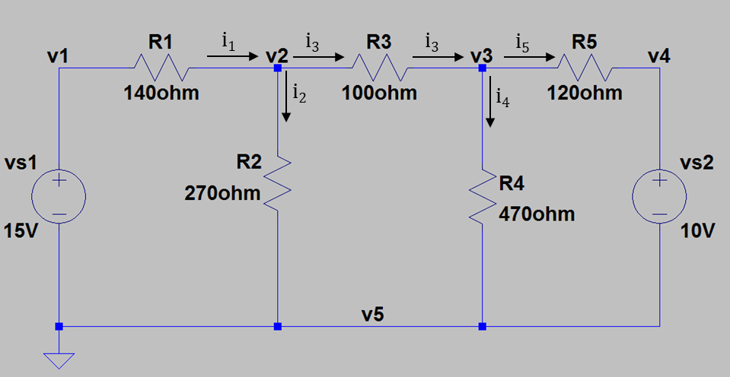
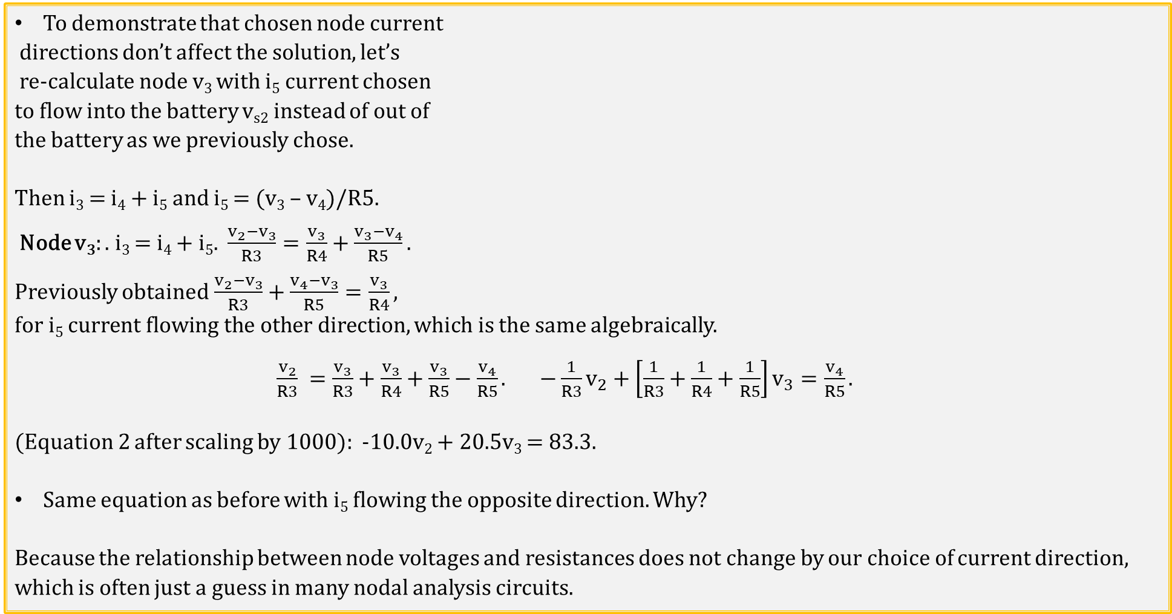
Nodal Analysis Example 2 (Continued)
To demonstrate that chosen node current
directions don’t affect the solution, let’s
re-calculate node v₃ with i₅ current chosen
to flow into the battery v_{s2} instead of out of
the battery as we previously chose.
Then i₃ = i₄ + i₅ and i₅ = (v₃ – v₄)/R5.
Node v₃: . i₃ = i₄ + i₅. $\frac{v_{2}−v_{3}}{R3}=\frac{v_{3}}{R4}+\frac{v_{3}−v_{4}}{R5}.$
Previously obtained$\frac{v_{2}−v_{3}}{R3}+\frac{v_{4}−v_{3}}{R5}=\frac{v_{3}}{R4},$
$\text{f}\text{or} \text{i}\text{5} \text{current} \text{flowing} \text{the} \text{other} \text{direction}, which is$the same algebraically.
$\frac{v_{2}}{R3} =\frac{v_{3}}{R3}+\frac{v_{3}}{R4}+\frac{v_{3}}{R5}−\frac{v_{4}}{R5}. −\frac{1}{R3}v_{2}+\left[\frac{1}{R3}+\frac{1}{R4}+\frac{1}{R5}\right]v_{3}=\frac{v_{4}}{R5}.$
(Equation 2 after scaling by 1000): -10.0v₂ + 20.5v₃ = 83.3.
Same equation as before with i₅ flowing the opposite direction. Why?
Because the relationship between node voltages and resistances does not change by our choice of current direction, which is often just a guess in many nodal analysis circuits.

Slide 11
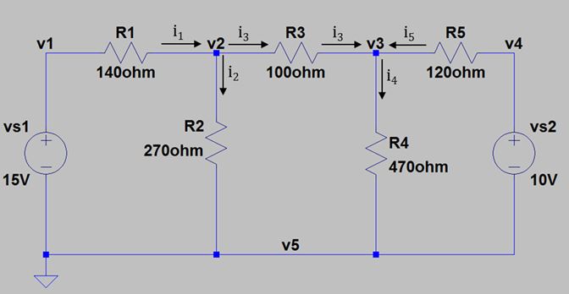
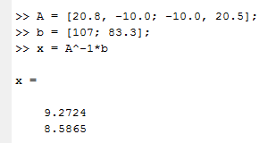
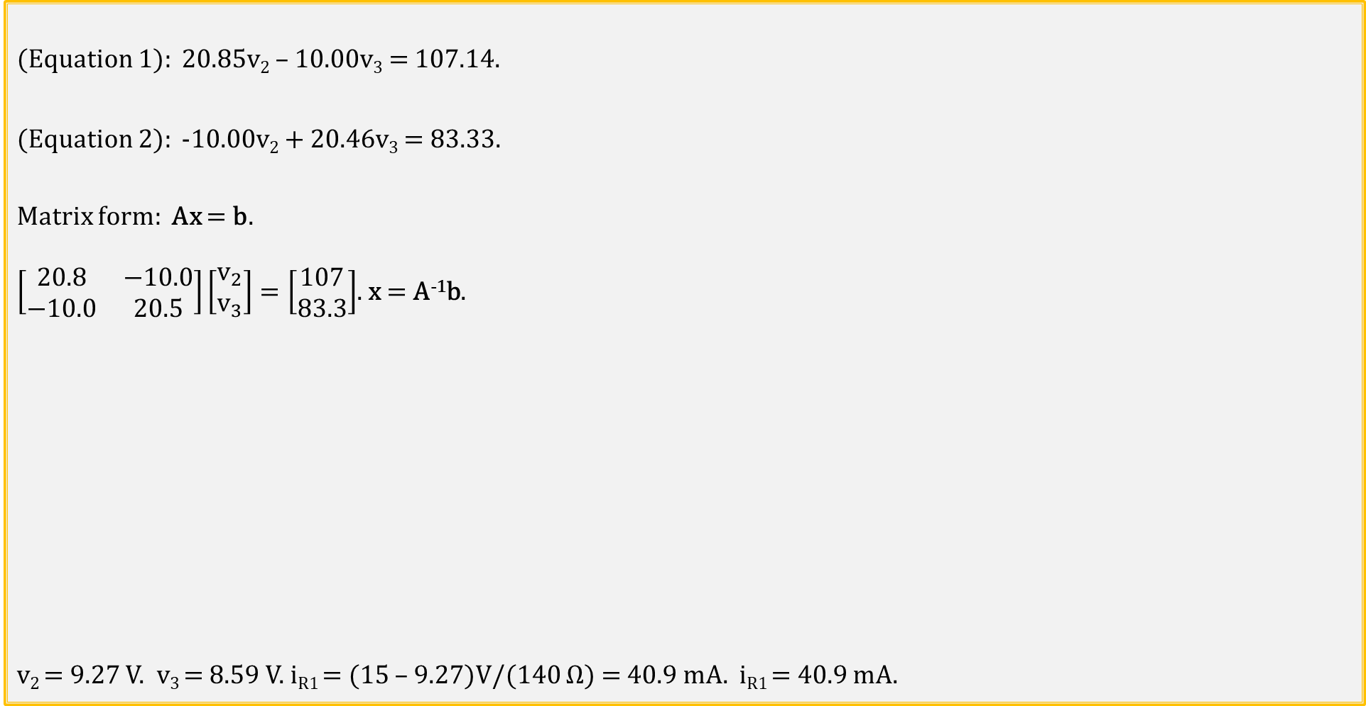
Nodal Analysis Example 2 (Continued)
(Equation 1): 20.85v₂ – 10.00v₃ = 107.14.
(Equation 2): -10.00v₂ + 20.46v₃ = 83.33.
Matrix form: Ax = b.
$\left[\begin{matrix}20.8 & −10.0 \\ −10.0 & 20.5\end{matrix}\right]\left[\begin{aligned}v_{2} \\ v_{3}\end{aligned}\right]=\left[\begin{aligned}107 \\ 83.3\end{aligned}\right]$. x = A⁻¹b.
v₂ = 9.27 V. v₃ = 8.59 V. i_{R1} = (15 – 9.27)V/(140 Ω) = 40.9 mA. i_{R1} = 40.9 mA.
MATLAB Command Window

Slide 12
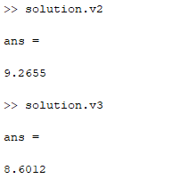
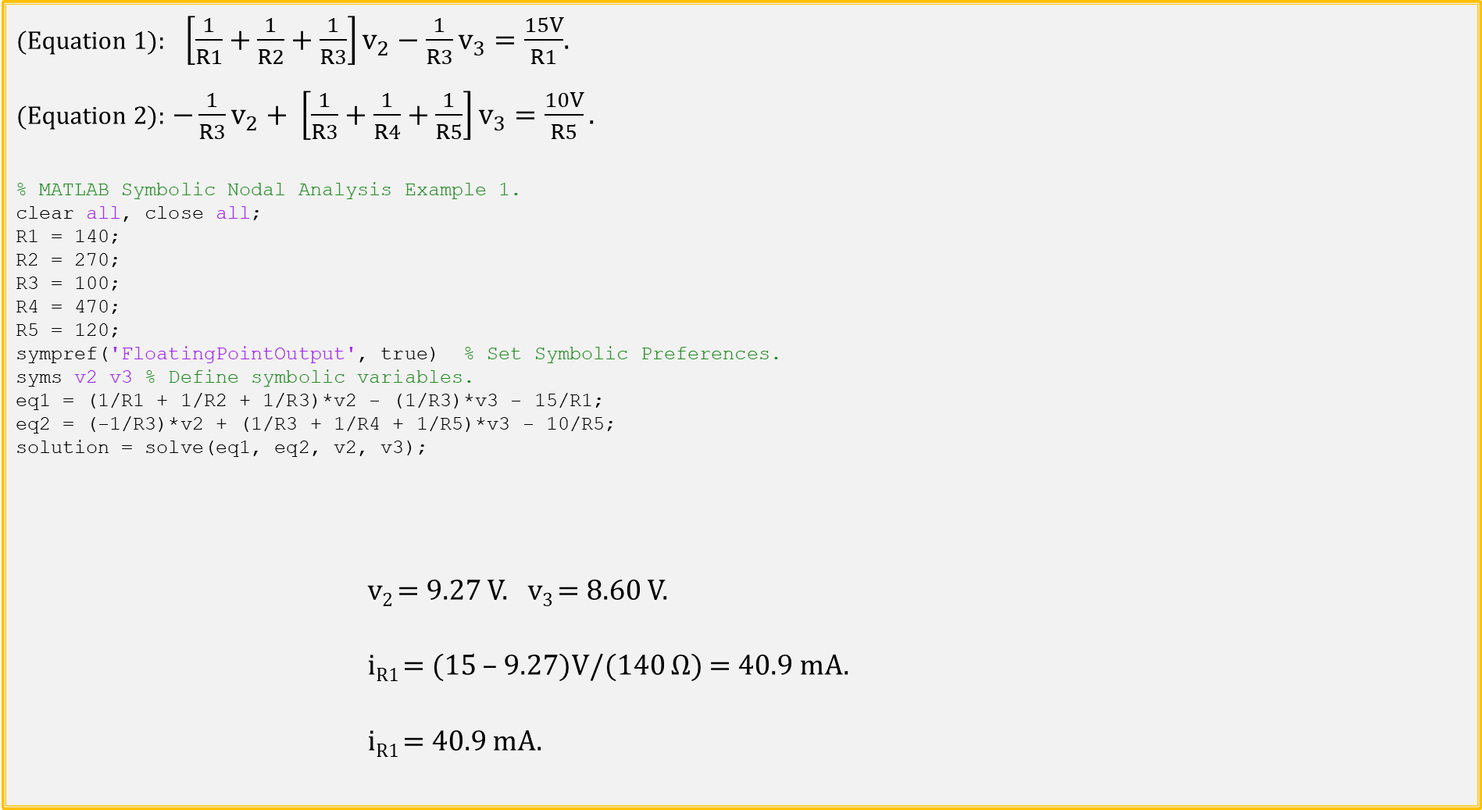
Nodal Analysis Using MATLAB Symbolic Capability
(Equation 1): $\left[\frac{1}{R1}+\frac{1}{R2}+\frac{1}{R3}\right]v_{2}−\frac{1}{R3}v_{3}=\frac{15V}{R1}$.
(Equation 2): $−\frac{1}{R3}v_{2}+ \left[\frac{1}{R3}+\frac{1}{R4}+\frac{1}{R5}\right]v_{3}=\frac{10V}{R5}.$
% MATLAB Symbolic Nodal Analysis Example 1.
clear all, close all;
R1 = 140;
R2 = 270;
R3 = 100;
R4 = 470;
R5 = 120;
sympref('FloatingPointOutput', true) % Set Symbolic Preferences.
syms v2 v3 % Define symbolic variables.
eq1 = (1/R1 + 1/R2 + 1/R3)*v2 - (1/R3)*v3 - 15/R1;
eq2 = (-1/R3)*v2 + (1/R3 + 1/R4 + 1/R5)*v3 - 10/R5;
solution = solve(eq1, eq2, v2, v3);
v₂ = 9.27 V. v₃ = 8.60 V.
i_{R1} = (15 – 9.27)V/(140 Ω) = 40.9 mA.
i_{R1} = 40.9 mA.

Slide 13
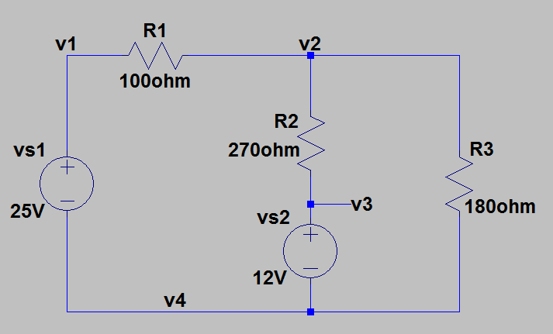
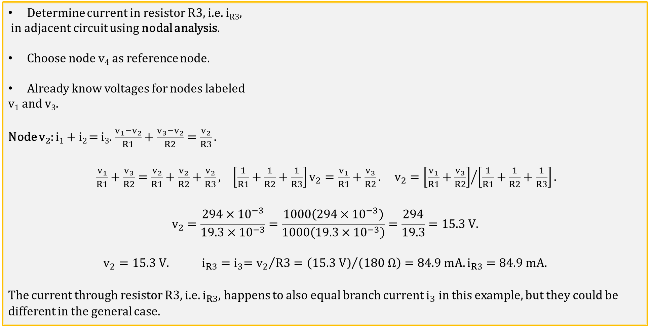
Nodal Analysis Example 3
Determine current in resistor R3, i.e. i_{R3},
in adjacent circuit using nodal analysis.
Choose node v₄ as reference node.
Already know voltages for nodes labeled
v₁ and v₃.
Node v₂: i₁ + i₂ = i₃. $\frac{v_{1}−v_{2}}{R1}+\frac{v_{3}−v_{2}}{R2}=\frac{v_{2}}{R3}.$
$\frac{v_{1}}{R1}+\frac{v_{3}}{R2}=\frac{v_{2}}{R1}+\frac{v_{2}}{R2}+\frac{v_{2}}{R3}, \left[\frac{1}{R1}+\frac{1}{R2}+\frac{1}{R3}\right]v_{2}=\frac{v_{1}}{R1}+\frac{v_{3}}{R2}. v_{2}={\left[\frac{v_{1}}{R1}+\frac{v_{3}}{R2}\right]}/{\left[\frac{1}{R1}+\frac{1}{R2}+\frac{1}{R3}\right]}.$
$$v_{2}=\frac{294×{10}^{−3}}{19.3×{10}^{−3}}=\frac{1000\left(294×{10}^{−3}\right)}{1000\left(19.3×{10}^{−3}\right)}=\frac{294}{19.3}=15.3 V.$$
$$v_{2}=15.3 V. i_{R3}{=i}_{3}={v_{2}}/{R3}={\left(15.3 V\right)}/{\left(180 Ω\right)=84.9 mA.}i_{R3}=84.9 mA.$$
The current through resistor R3, i.e. $i_{R3}$, happens to also equal branch current $i_{3}$ in this example, but they could be different in the general case.
i₁
i₃
i₂

Slide 14
Circuit Terminology
Circuit comes from Latin, meaning to “go around”.
Open Circuit indicates that there is a gap or opening in the circuit so that no current flows. The gap or opening may be an open switch.
Closed circuit indicates that there is a complete path for current to flow around the circuit. Any switches in the circuit must be closed to form a closed circuit.
Short Circuit indicates that a very low resistance path is connected across an element, resulting in the current bypassing the element that is shorted, since current flows through the path of least resistance.
Branch – A single element, such as a voltage source or resistor.
Node – A electrical connection between two or more elements, having negligible resistance. Low-resistance wires form nodes in practical circuits
Loop – Any closed path in a circuit.
Mesh – A loop that does not contain any other loop within it. (Window pane).
Series connected elements exclusively share a single node, and therefore carry the same current. End-to-end series connected elements have the same current flowing through them.
Parallel connected elements are connected across the same two nodes. Therefore parallel connected elements have the same voltage across them.
Notes:
Image by instructor

Slide 15
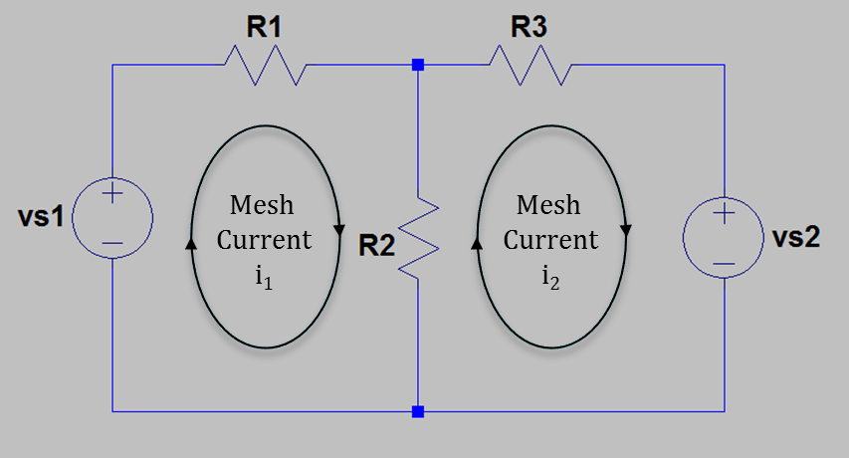
Mesh (Loop) Analysis
Another algorithmic approach.
The adjacent circuit has two meshes, i.e. Mesh 1 and Mesh 2.
Resistor R2 is common to both meshes with
i_{R2} being algebraic sum of i₁ and i₂ mesh currents.
Convention is to define clockwise mesh currents. If actual
current flow is in the opposite direction of a clockwise then the
solved for mesh current will have a negative sign.
Mesh current i₁ also equals branch current i_{R1}, and mesh current i₂ also equals branch current i_{R3}. Branch current i_{R2} equals algebraic sum of i₁ and i₂ mesh currents.
Use KVL to write voltage equations for meshes 1 and 2.
Mesh 1: -v_{s1} + i₁R1 + i₁R2 – i₂R2 = 0, (R1 + R2)i₁ – R2i₂ = v_{s1}.
Mesh 2: i₂R2 - i₁R2 + i₂R3 + v_{s2} = 0, -R2i₁ + (R2 + R3)i₂ = -v_{s2}.
Solve for mesh currents i₁ and i₂.
Mesh analysis uses KVL to arrive at mesh currents.

Slide 16
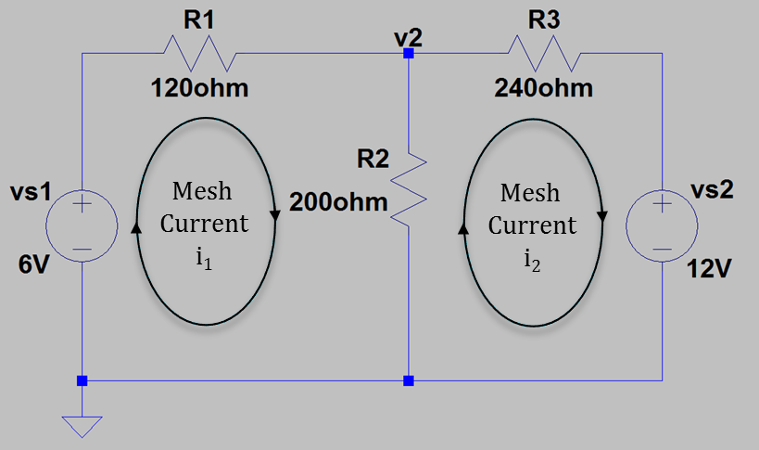
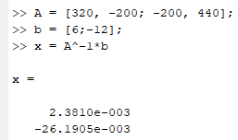
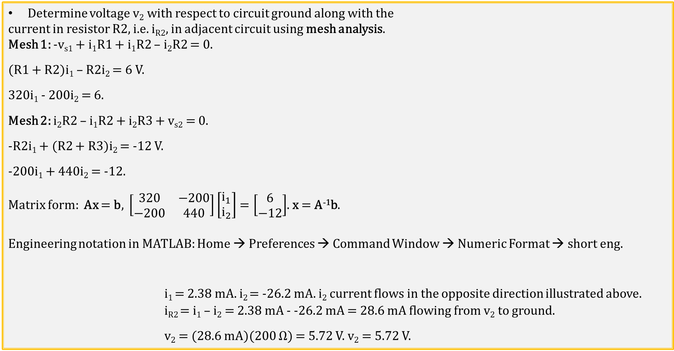
Mesh (Loop) Analysis Example 1
Determine voltage v₂ with respect to circuit ground along with the
current in resistor R2, i.e. i_{R2}, in adjacent circuit using mesh analysis.
Mesh 1: -v_{s1} + i₁R1 + i₁R2 – i₂R2 = 0.
(R1 + R2)i₁ – R2i₂ = 6 V.
320i₁ - 200i₂ = 6.
Mesh 2: i₂R2 – i₁R2 + i₂R3 + v_{s2} = 0.
-R2i₁ + (R2 + R3)i₂ = -12 V.
-200i₁ + 440i₂ = -12.
Matrix form: Ax = b, $\left[\begin{matrix}320 & −200 \\ −200 & 440\end{matrix}\right]\left[\begin{aligned}i_{1} \\ i_{2}\end{aligned}\right]=\left[\begin{aligned}6 \\ −12\end{aligned}\right]$. x = A⁻¹b.
Engineering notation in MATLAB: Home → Preferences → Command Window → Numeric Format → short eng.
i₁ = 2.38 mA. i₂ = -26.2 mA. i₂ current flows in the opposite direction illustrated above.
i_{R2} = i₁ – i₂ = 2.38 mA - -26.2 mA = 28.6 mA flowing from v₂ to ground.
v₂ = (28.6 mA)(200 Ω) = 5.72 V. v₂ = 5.72 V.

Slide 17
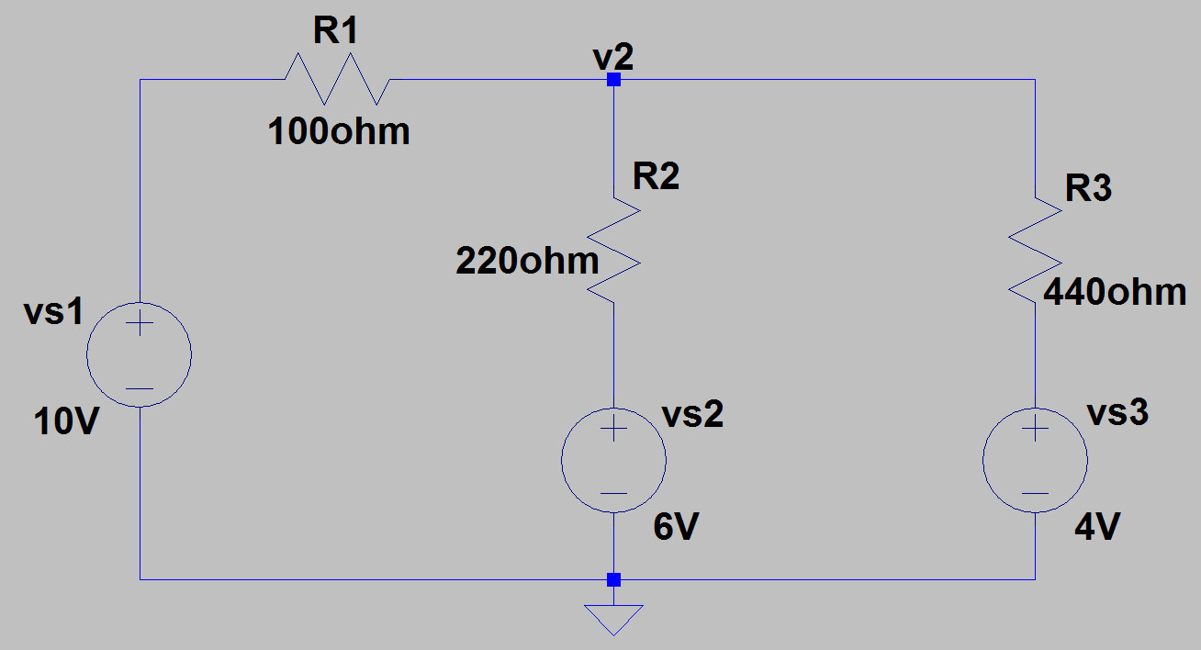
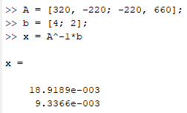
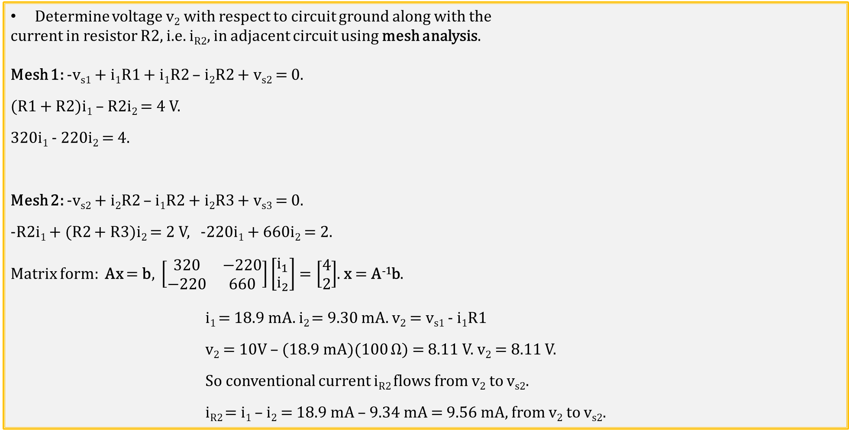
Mesh (Loop) Analysis Example 2
Determine voltage v₂ with respect to circuit ground along with the
current in resistor R2, i.e. i_{R2}, in adjacent circuit using mesh analysis.
Mesh 1: -v_{s1} + i₁R1 + i₁R2 – i₂R2 + v_{s2} = 0.
(R1 + R2)i₁ – R2i₂ = 4 V.
320i₁ - 220i₂ = 4.
Mesh 2: -v_{s2} + i₂R2 – i₁R2 + i₂R3 + v_{s3} = 0.
-R2i₁ + (R2 + R3)i₂ = 2 V, -220i₁ + 660i₂ = 2.
Matrix form: Ax = b, $\left[\begin{matrix}320 & −220 \\ −220 & 660\end{matrix}\right]\left[\begin{aligned}i_{1} \\ i_{2}\end{aligned}\right]=\left[\begin{aligned}4 \\ 2\end{aligned}\right]$. x = A⁻¹b.
i₁ = 18.9 mA. i₂ = 9.30 mA. v₂ = v_{s1} - i₁R1
v₂ = 10V – (18.9 mA)(100 Ω) = 8.11 V. v₂ = 8.11 V.
So conventional current i_{R2} flows from v₂ to v_{s2}.
i_{R2} = i₁ – i₂ = 18.9 mA – 9.34 mA = 9.56 mA, from v₂ to v_{s2}.
Mesh
Current
i₁
Mesh
Current
i₂
5 Poll Questions

Slide 18
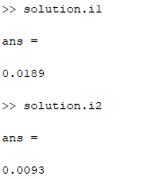
Mesh (Loop) Analysis Example 2 (Continued)
Determine voltage v₂ with respect to circuit
ground along with the current in resistor R2,
i.e. i_{R2}, in adjacent circuit using mesh analysis.
Mesh 1: (R1 + R2)i₁ – R2i₂ = 4 V.
Mesh 2: -R2i₁ + (R2 + R3)i₂ = 2 V.
% MATLAB Symbolic Mesh Analysis Example 1.
clear all, close all;
R1 = 100;
R2 = 220;
R3 = 440;
sympref('FloatingPointOutput', true) % Set Symbolic Preferences.
syms i1 i2 % Define symbolic variables.
eq1 = (R1 + R2)*i1 - R2*i2 - 4;
eq2 = -R2*i1 + (R2 + R3)*i2 - 2;
solution = solve(eq1, eq2, i1, i2);
sympref(), i.e. symbolic preferences doesn’t have an engineering notation output option.
i₁ = 18.9 mA. i₂ = 9.30 mA. v₂ = v_{s1} - i₁R1
v₂ = 10V – (18.9 mA)(100 Ω) = 8.11 V. v₂ = 8.11 V.
So conventional current i_{R2} flows from v₂ to v_{s2}.
i_{R2} = i₁ – i₂ = 9.6 mA.
i_{R2} = 9.6 mA.
Mesh
Current
i₁
Mesh
Current
i₂

Slide 19
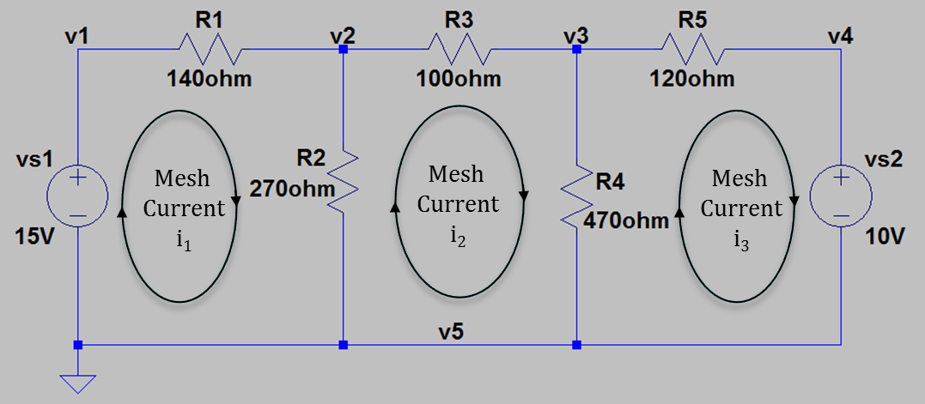
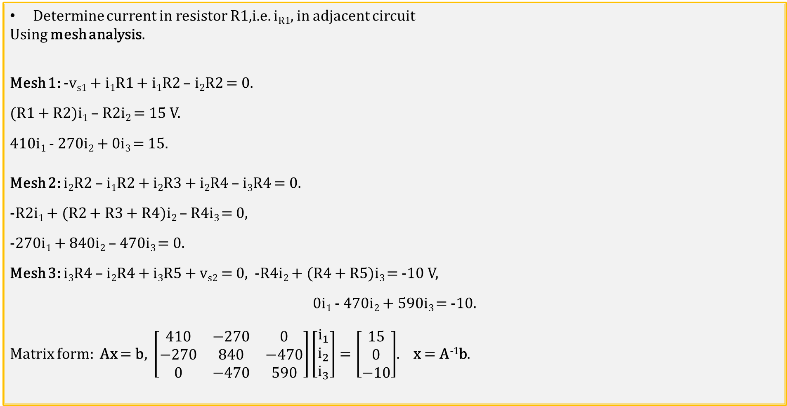
Mesh (Loop) Analysis Example 3
Determine current in resistor R1,i.e. i_{R1}, in adjacent circuit
Using mesh analysis.
Mesh 1: -v_{s1} + i₁R1 + i₁R2 – i₂R2 = 0.
(R1 + R2)i₁ – R2i₂ = 15 V.
410i₁ - 270i₂ + 0i₃ = 15.
Mesh 2: i₂R2 – i₁R2 + i₂R3 + i₂R4 – i₃R4 = 0.
-R2i₁ + (R2 + R3 + R4)i₂ – R4i₃ = 0,
-270i₁ + 840i₂ – 470i₃ = 0.
Mesh 3: i₃R4 – i₂R4 + i₃R5 + v_{s2} = 0, -R4i₂ + (R4 + R5)i₃ = -10 V,
0i₁ - 470i₂ + 590i₃ = -10.
Matrix form: Ax = b, $\left[\begin{matrix}410 & −270 & 0 \\ −270 & 840 & −470 \\ 0 & −470 & 590\end{matrix}\right]\left[\begin{matrix}i_{1} \\ i_{2} \\ i_{3}\end{matrix}\right]=\left[\begin{matrix}15 \\ 0 \\ −10\end{matrix}\right]$. x = A⁻¹b.

Slide 20
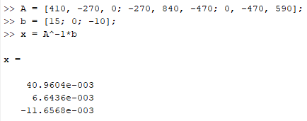
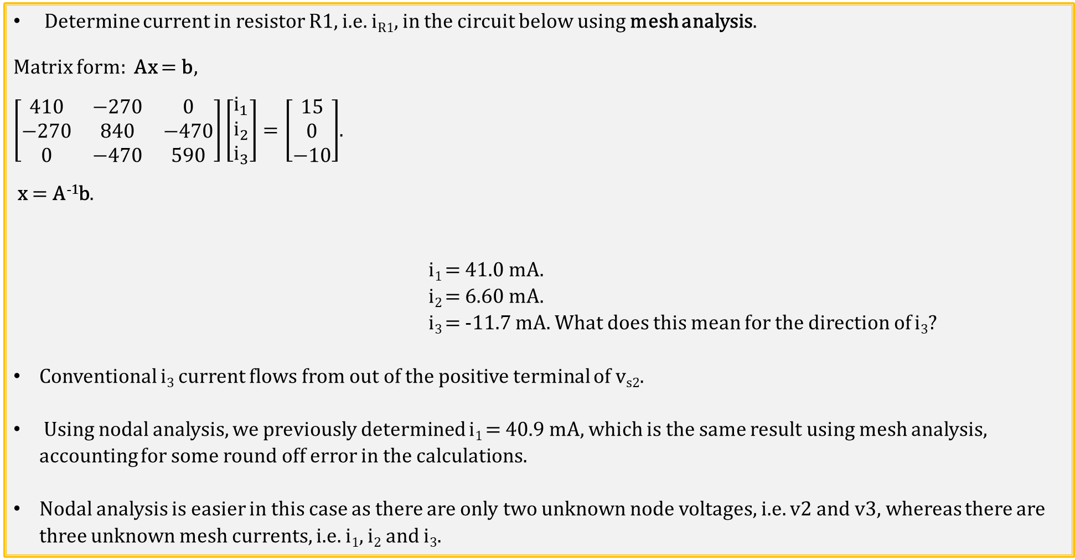
Mesh (Loop) Analysis Example 3 (Continued)
Determine current in resistor R1, i.e. i_{R1}, in the circuit below using mesh analysis.
Matrix form: Ax = b,
$\left[\begin{matrix}410 & −270 & 0 \\ −270 & 840 & −470 \\ 0 & −470 & 590\end{matrix}\right]\left[\begin{matrix}i_{1} \\ i_{2} \\ i_{3}\end{matrix}\right]=\left[\begin{matrix}15 \\ 0 \\ −10\end{matrix}\right]$.
x = A⁻¹b.
i₁ = 41.0 mA.
i₂ = 6.60 mA.
i₃ = -11.7 mA. What does this mean for the direction of i₃?
Conventional i₃ current flows from out of the positive terminal of v_{s2}.
Using nodal analysis, we previously determined i₁ = 40.9 mA, which is the same result using mesh analysis, accounting for some round off error in the calculations.
Nodal analysis is easier in this case as there are only two unknown node voltages, i.e. v2 and v3, whereas there are three unknown mesh currents, i.e. i₁, i₂ and i₃.

Slide 21
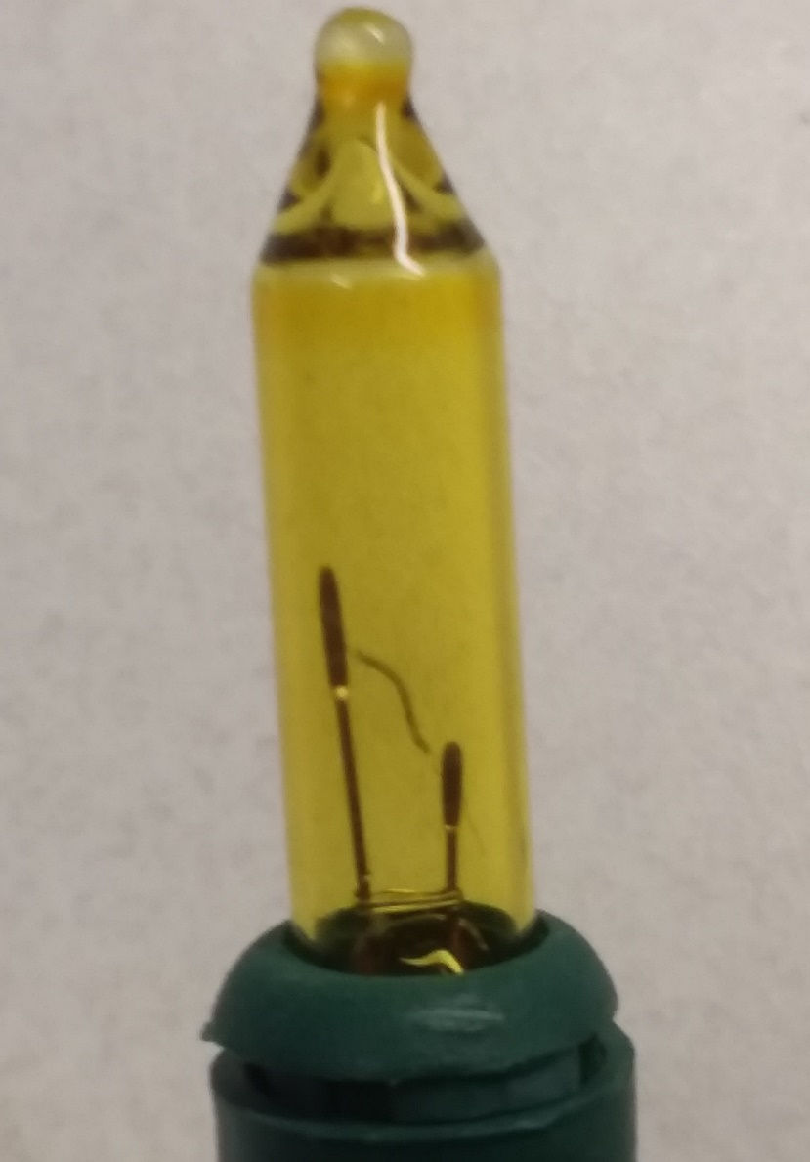
Series Circuit Application – Christmas Tree Lights
Common Christmas Tree lights use series
strings of 50 bulbs, so that each bulb has less
than 5 V across it.
Obvious problem with series string is that a
broken filament in one bulb takes out the entire
string and is hard to find.
Engineering to the rescue.
Standard mini-light bulb with insulated shunt
wire in case the filament breaks.
Broken filament results in entire string voltage
across one bulb, which heats the insulated shunt
wire, melting off the insulation and then shorting
across the two leads.
Result is broken filament does not take out entire
series string and bad bulb can easily be found.
Filament
Shunt Wire
Notes:
Image by instructor

Slide 22
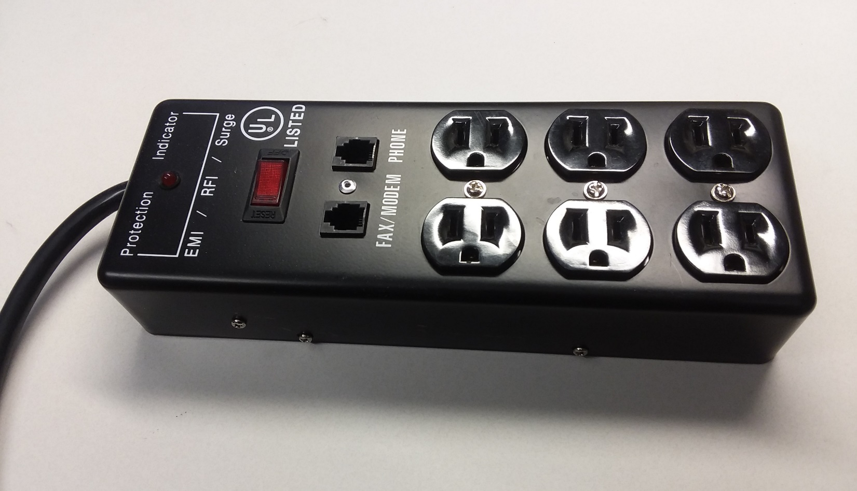
Parallel Circuit Application – Terminal Strip
On/off switch and surge protection often included in terminal strips.
Several parallel high-current loads can exceed home circuit breakers.
Notes:
Image by instructor

Slide 23
Electrical Power Supplies
Power supplies provide electrical energy.
2 Major Types of Electrical Power Supplies:
Voltage Sources.
Current Sources.
Ideal voltage source provides constant voltage at the terminals for any load current.
Electrochemical batteries are good examples of a voltage source.
Ideal current source provides constant current at the terminals for any load voltage.
Solar panels are good examples of a current source.
How Do Batteries Work (4:19)
Notes:
Image by instructor

Slide 24
Series and Parallel Voltage Sources
Series Voltage Sources → Good idea.
Batteries with voltages > 4 V are usually strings of series connected cells.
Parallel Voltage Sources → Beware!
Voltage differences between parallel voltage sources can result in large currents!
Problems can arise when replacing just one of multiple parallel connected batteries because fresh battery will have a larger voltage, resulting in hard work for the fresh battery.
Common parallel battery example is jump starting a car with a dead battery.
Meter leads used in STC 215 would likely be damaged if used to jump start a car.
Jumper cables are designed to handle > 100 A.
Notes:
Image by instructor

Slide 25
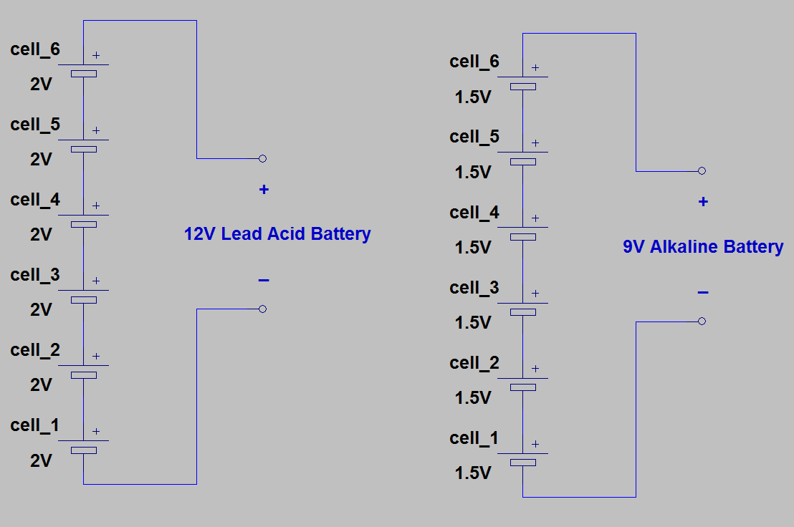
Series Voltage Sources
Series Voltage Sources → Good idea.
Batteries with voltages > 4 V are usually strings of series connected cells.
Notes:
Image by instructor

Slide 26
The End

Slide 27
Test Time – Just for Fun. No Points.

Slide 28
Nodal and Mesh Analysis Quiz (1:4)
Which of the following is the best answer for a node in circuit analysis?
1. The voltage is 0 V across a node.
2. The voltage is the same across a node.
3. The current is 0 A across a node.
4. The current is the same across a node.
The voltage is the same across a node.
In circuit analysis, which of the following is the best definition of a mesh?
1. A loop that does not contain any other loops within it.
2. An equipotential surface.
3. A loop with equal current.
4. A loop that is a mess to solve.
A loop that does not contain any other loop within it. (Independent loop)

Slide 29
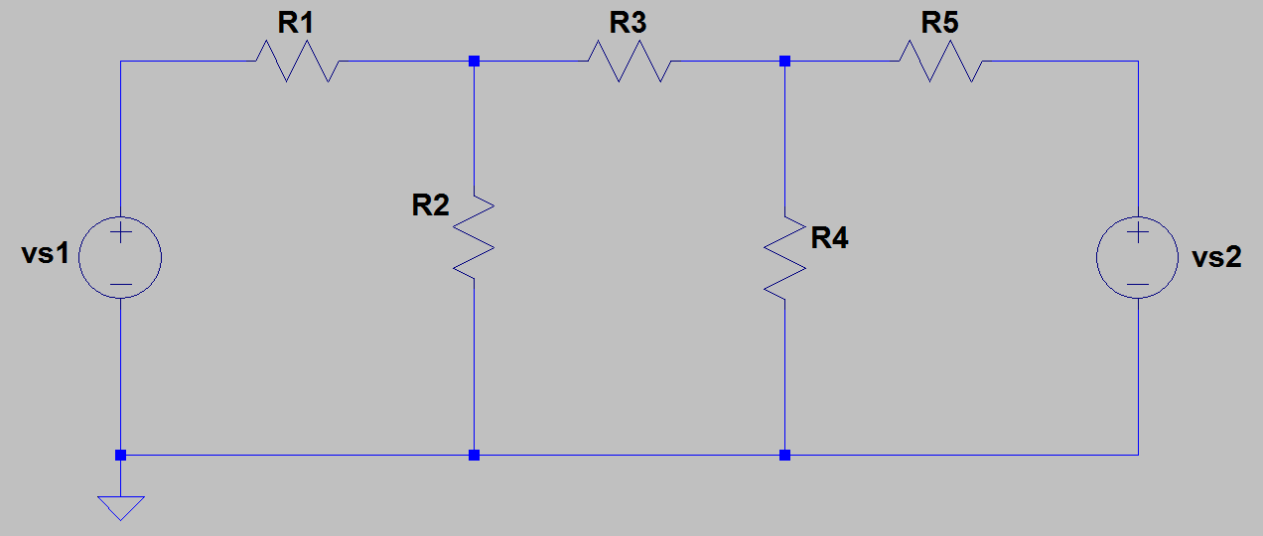
Nodal and Mesh Analysis Quiz (2:4)
How many nodes are in the adjacent circuit?
2.
3.
4.
5.
5.
Which node would be the best reference node for nodal analysis?
v5, because it has the most elements connected to it.
How many unknown node voltages are in the above circuit?
2.
3.
4.
5.
2. v2 and v3
v1
v2
v3
v4
v5

Slide 30
Nodal and Mesh Analysis Quiz (3:4)
Nodal analysis solves for which of the following?
1. Voltages.
2. Currents.
3. Resistances.
4. Power.
Nodal analysis solves for node voltages.
Nodal analysis uses which of the following of Kirchhoff’s laws?
1. KVL.
2. KCL.
KCL. Nodal analysis uses KCL to arrive at node voltages.

Slide 31
Nodal and Mesh Analysis Quiz (4:4)
Mesh analysis solves for which of the following?
1. Voltages.
2. Currents.
3. Resistances.
4. Power.
Mesh analysis solves for mesh currents.
Mesh analysis uses which of the following of Kirchhoff’s laws?
1. KVL.
2. KCL.
KVL. Mesh analysis uses KVL to arrive at mesh currents.

Slide 32
Extra

Slide 33
Supernodes
Nodal analysis relies on Kirchhoff’s Current Law, i.e. KCL, to arrive at independent equations in order to solve for unknown node voltages.
An ideal voltage source provides the necessary current to maintain the desired voltage. Hence, the current provided by a voltage source is not known in advance.
Voltage sources not connected to the circuit reference node, actually simplify nodal analysis, since an ideal voltage source forces a known voltage difference between nodes.
A voltage source connected between two non-reference nodes forms what is referred to as a supernode, which is actually two nodes with a known voltage difference between them.
Kirchhoff’s Current Law, i.e. KCL, applies to closed boundaries, so can draw a boundary around a supernode and apply KCL to that boundary.
Supernodes actually simplify nodal analysis by reduce the number of necessary node equations.

Slide 34
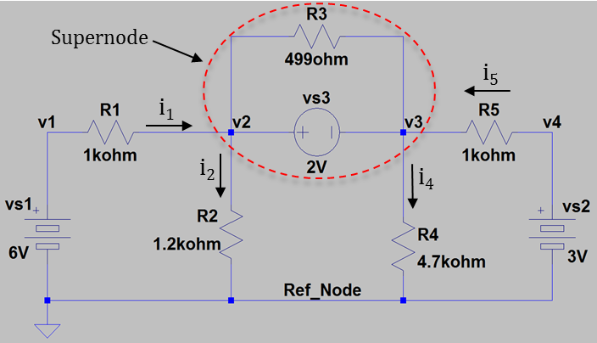
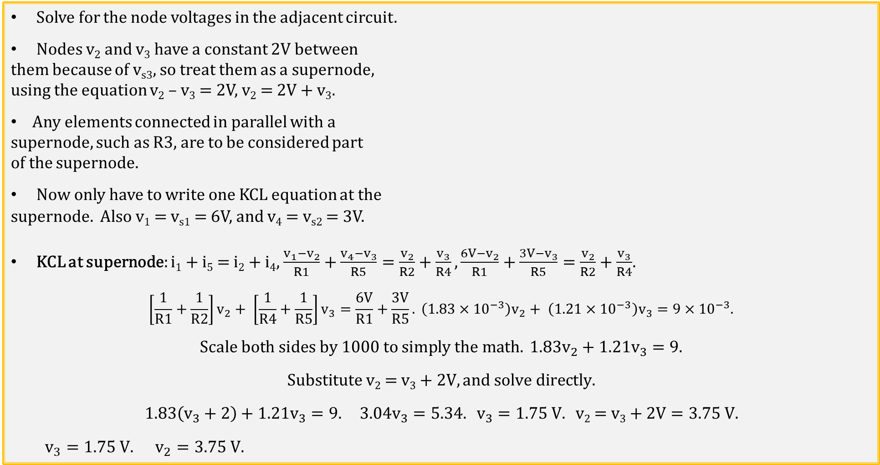
Supernode Example 1
Solve for the node voltages in the adjacent circuit.
Nodes v₂ and v₃ have a constant 2V between
them because of v_{s3}, so treat them as a supernode,
using the equation v₂ – v₃ = 2V, v₂ = 2V + v₃.
Any elements connected in parallel with a
supernode, such as R3, are to be considered part
of the supernode.
Now only have to write one KCL equation at the
supernode. Also v₁ = v_{s1} = 6V, and v₄ = v_{s2} = 3V.
KCL at supernode: i₁ + i₅ = i₂ + i₄, $\frac{v_{1}−v_{2}}{R1}+\frac{v_{4}−v_{3}}{R5}=\frac{v_{2}}{R2}+\frac{v_{3}}{R4},\frac{6V−v_{2}}{R1}+\frac{3V−v_{3}}{R5}=\frac{v_{2}}{R2}+\frac{v_{3}}{R4}$.
$$\left[\frac{1}{R1}+\frac{1}{R2}\right]v_{2}+ \left[\frac{1}{R4}+\frac{1}{R5}\right]v_{3}=\frac{6V}{R1}+\frac{3V}{R5}. \left(1.83×{10}^{−3}\right)v_{2}+ \left(1.21×{10}^{−3}\right)v_{3}=9×{10}^{−3}.$$
$$Scale both sides by 1000 to simply the math. 1.83v_{2}+1.21v_{3}=9.$$
$$Substitute \text{v}\text{2}\text{ = }\text{v}\text{3}\text{ + 2}\text{V}, and solve directly.$$
$$1.83\left(v_{3}+2\right)+1.21v_{3}=9. 3.04v_{3}=5.34. v_{3}=1.75 V. \text{v}\text{2}\text{ = }\text{v}\text{3}\text{ + 2}\text{V}=3.75 V.$$
$$v_{3}=1.75 V. v_{2}=3.75 V.$$

Slide 35
Supermeshes
Mesh analysis relies on Kirchhoff’s Voltage Law, i.e. KVL, to arrive at independent equations in order to solve for unknown mesh currents.
An ideal current source provides the necessary voltage to maintain the desired current. Hence, the voltage across a current source is not known in advance.
Current sources common between meshes, actually simplify mesh analysis, since an ideal current source forces a known branch current, reducing the number of unknown currents.
A current source common between meshes forms what is referred to as a supermesh, which is actually two or more meshes combined, each with a possibly different mesh current.
Kirchhoff’s Voltage Law, i.e. KVL, can be applied to a resulting supermesh in order to solve for unknown mesh currents.
Supermeshes actually simplify mesh analysis by reducing the number of necessary mesh equations.

Slide 36
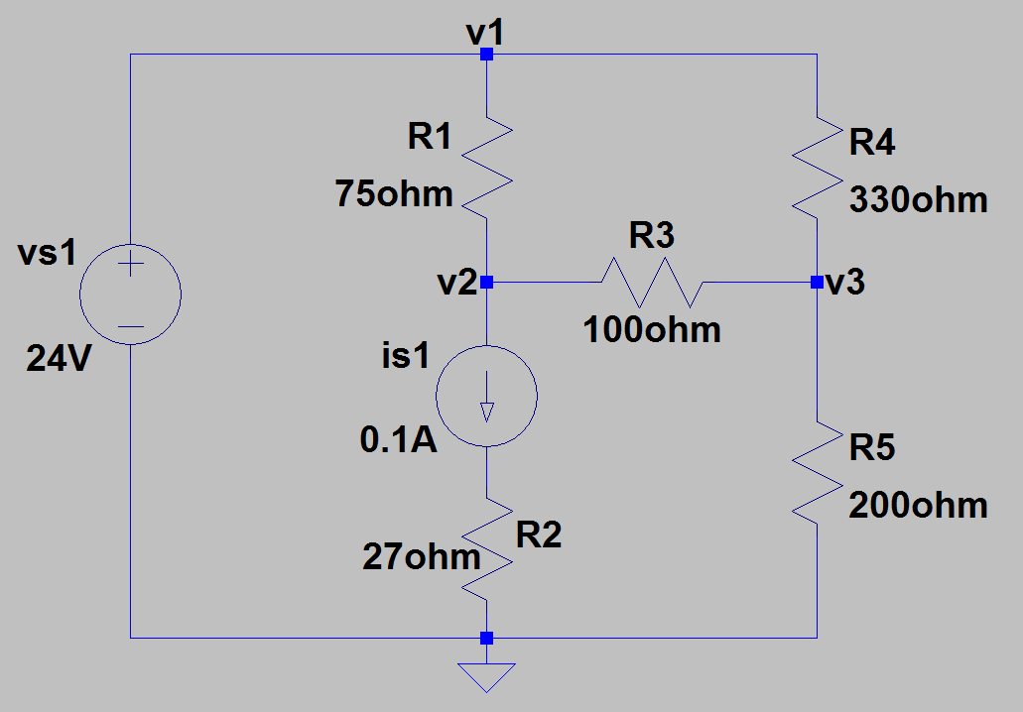
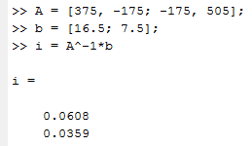
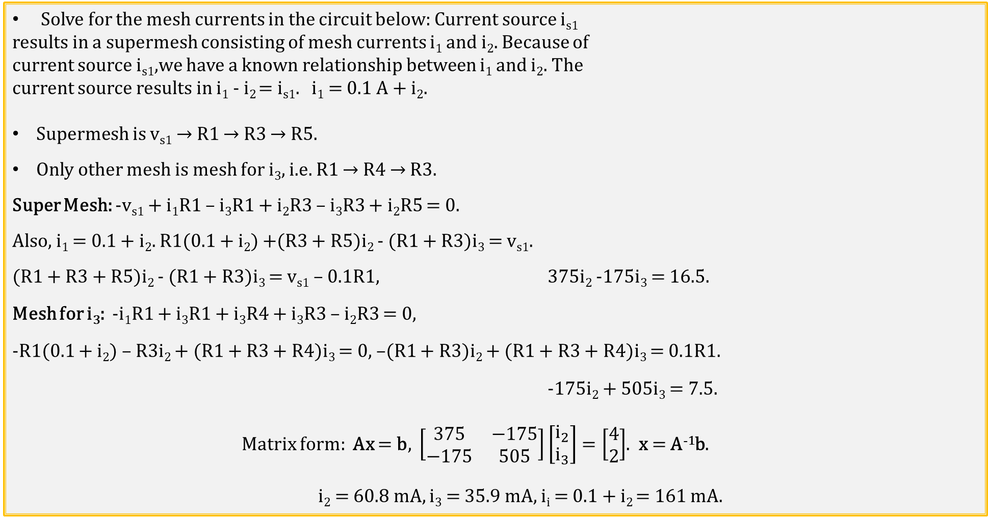
Supermesh Example 1
Solve for the mesh currents in the circuit below: Current source i_{s1}
results in a supermesh consisting of mesh currents i₁ and i₂. Because of
current source i_{s1},we have a known relationship between i₁ and i₂. The
current source results in i₁ - i₂ = i_{s1}. i₁ = 0.1 A + i₂.
Supermesh is v_{s1} → R1 → R3 → R5.
Only other mesh is mesh for i₃, i.e. R1 → R4 → R3.
Super Mesh: -v_{s1} + i₁R1 – i₃R1 + i₂R3 – i₃R3 + i₂R5 = 0.
Also, i₁ = 0.1 + i₂. R1(0.1 + i₂) +(R3 + R5)i₂ - (R1 + R3)i₃ = v_{s1}.
(R1 + R3 + R5)i₂ - (R1 + R3)i₃ = v_{s1} – 0.1R1, 375i₂ -175i₃ = 16.5.
Mesh for i₃: -i₁R1 + i₃R1 + i₃R4 + i₃R3 – i₂R3 = 0,
-R1(0.1 + i₂) – R3i₂ + (R1 + R3 + R4)i₃ = 0, –(R1 + R3)i₂ + (R1 + R3 + R4)i₃ = 0.1R1.
-175i₂ + 505i₃ = 7.5.
Matrix form: Ax = b, $\left[\begin{matrix}375 & −175 \\ −175 & 505\end{matrix}\right]\left[\begin{aligned}i_{2} \\ i_{3}\end{aligned}\right]=\left[\begin{aligned}4 \\ 2\end{aligned}\right]$. x = A⁻¹b.
i₂ = 60.8 mA, i₃ = 35.9 mA, i_{i} = 0.1 + i₂ = 161 mA.
i₃
i₁
i₂

Slide 37
Nodal and Mesh Analysis Summary
Node – A point of connection between two or more elements.
Nodal Analysis is based on KCL with unknowns being unknown node voltages.
Choosing a convenient reference node simplifies equations as all node voltages are then with respect to the reference node.
A voltage source connected between two non-reference nodes forms what is referred to as a supernode. Supernode contains more than one node.
Supernodes actually simplify nodal analysis by reduce the number of necessary node equations.
Mesh – A loop that does not contain any other loop within it. (Independent loop)
Mesh Analysis is based on KVL with unknowns being unknown mesh currents.
Convention assumes clockwise mesh currents.
A current source common between meshes forms what is referred to as a supermesh. A Supermesh contains inner loops.
Supermeshes actually simplify mesh analysis by reducing the number of necessary mesh equations.

